Slide 1
Advanced Image Analysis
a.a. 2017-2018, 2nd semester
Module 4
Image Segmentation
Alessandro Bria
Contract Professor
and Post-doc Researcher
email: a.bria@unicas.it

Slide 2
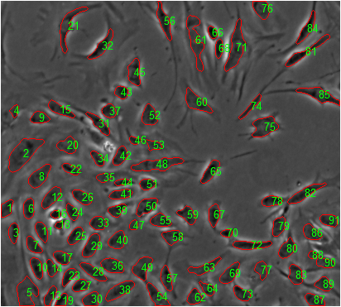
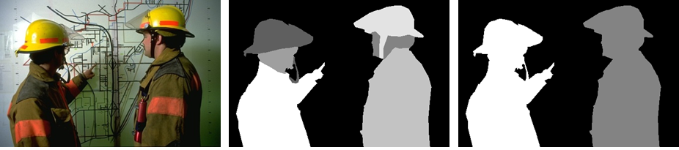
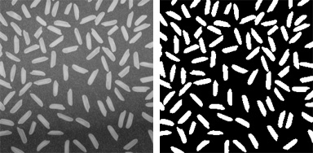
Image segmentation
segmentation subdivides an image into its constituent regions or objects
the level to which the subdivision is carried depends on the problem being solved
segmentation should stop when the objects of interest in an application have been isolated
segmentation of nontrivial images is one of the most difficult tasks in image analysis

Slide 3
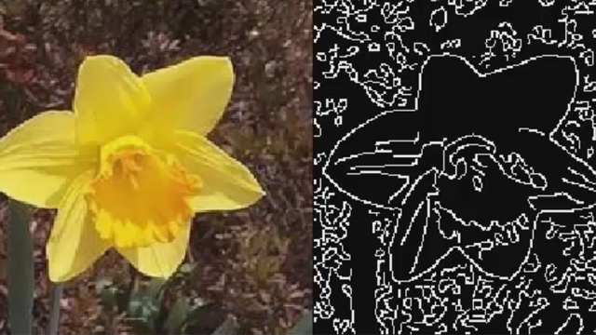
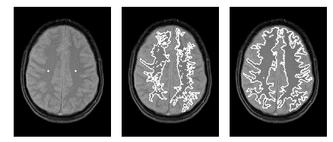
Image segmentation approaches
discontinuity- or edge-based
based on abrupt changes in intensity, such as edges
e.g. Marr-Hildreth, Canny
similarity- or region-based
based on identifying regions that are similar according to a set of predefined criteria
e.g. Thresholding, Region Growing, and Region Splitting and Merging
more complex approaches
Mean-Shift, Watershed, Graph-based methods (e.g. GrabCut), Active Contours, Level Sets, ...

Slide 4
Edge-based Segmentation (Gradient-based, Marr-Hildreth, Canny)

Slide 5
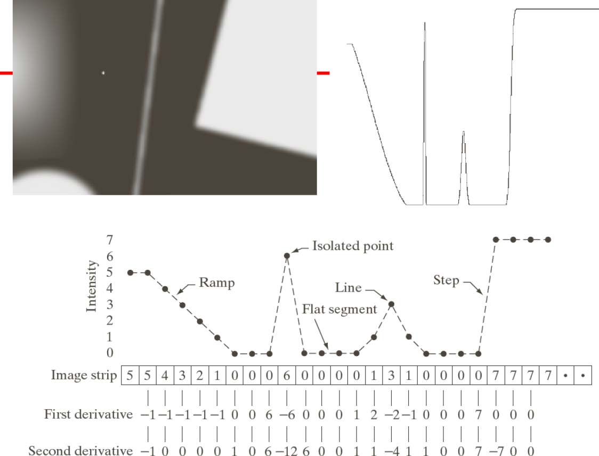
Discontinuity types
there are three main types of discontinuity that carry the information:
isolated (edge) point
abrupt local change of intensity
edge segment
connected set of discontinuity points
line
thin region where the intensity changes on both the sides

Slide 6
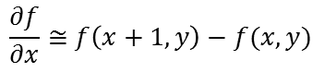
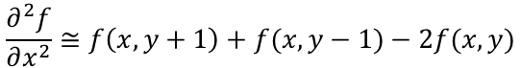
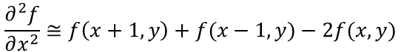
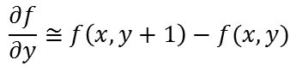
Derivatives
derivatives are good for detecting changes
but they are defined on continuous domains
since images are discrete, approximations have to be used (Taylor series)
$$\frac{∂f}{∂x}≅f\left(x+1,y\right)−f(x,y)$$
$$\frac{∂f}{∂y}≅f\left(x,y+1\right)−f(x,y)$$
$$\frac{∂^{2}f}{∂x^{2}}≅f\left(x+1,y\right)+f(x−1,y)−2f(x,y)$$
$$\frac{∂^{2}f}{∂x^{2}}≅f\left(x,y+1\right)+f(x,y−1)−2f(x,y)$$

Slide 7
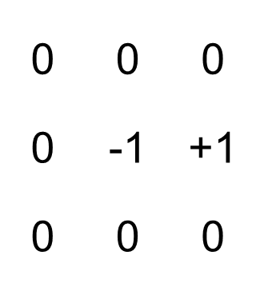
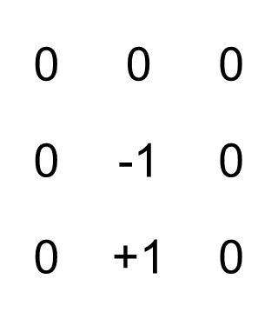
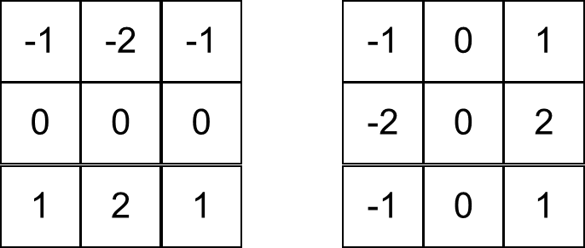
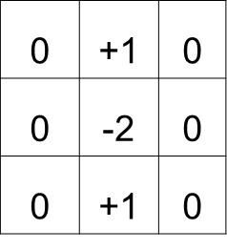
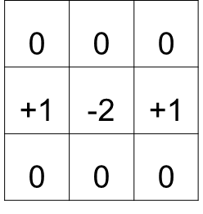
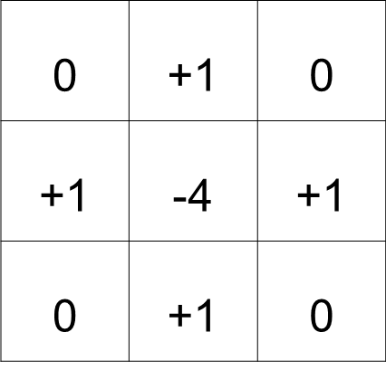
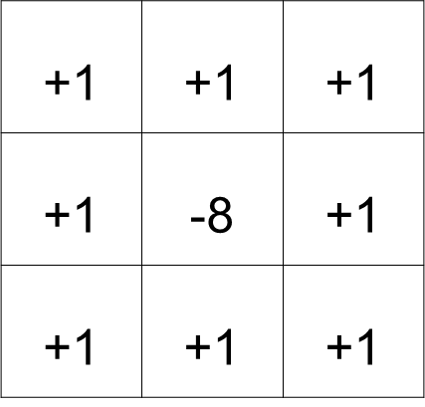
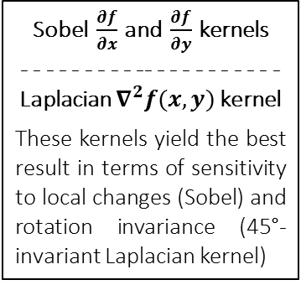
Derivatives with Sobel and Laplacian kernels
derivatives are good for detecting changes
but they are defined on continuous domains
since images are discrete, approximations have to be used (Taylor series)
Sobel $\frac{∂f}{∂x}$ and $\frac{∂f}{∂y}$ kernels
- - - - - - - - - -- - - - - - - - - - -
Laplacian $∇^{2}f(x,y)$ kernel
These kernels yield the best result in terms of sensitivity to local changes (Sobel) and rotation invariance (45°-invariant Laplacian kernel)
$$\frac{∂f}{∂x}≅f\left(x+1,y\right)−f(x,y)$$
$$\frac{∂f}{∂y}≅f\left(x,y+1\right)−f(x,y)$$
$$\frac{∂^{2}f}{∂x^{2}}≅f\left(x+1,y\right)+f(x−1,y)−2f(x,y)$$
$$\frac{∂^{2}f}{∂x^{2}}≅f\left(x,y+1\right)+f(x,y−1)−2f(x,y)$$

Slide 8
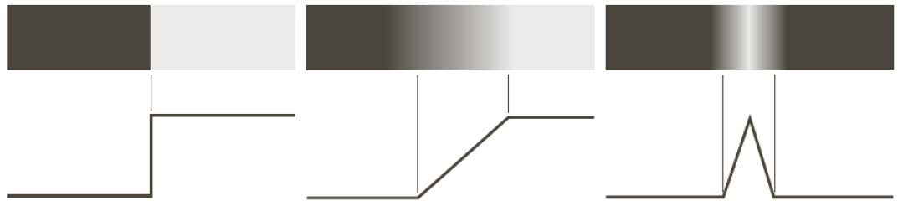
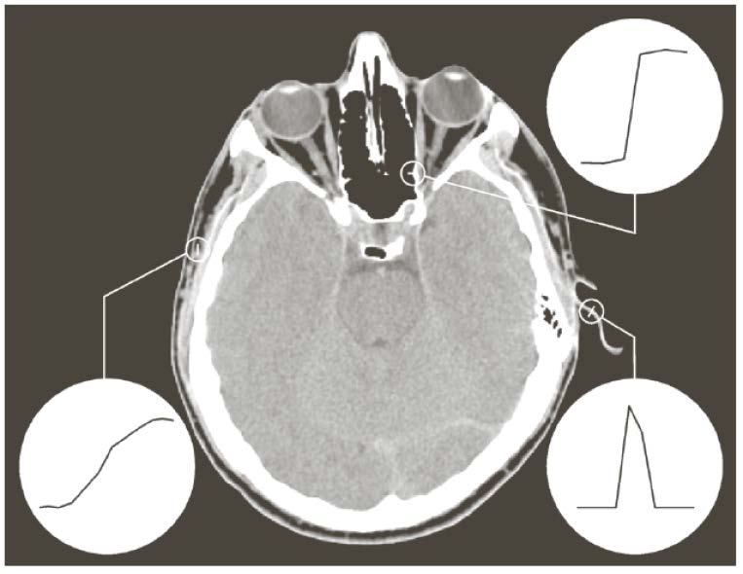
Edge models
ideal edges
real edges

Slide 9
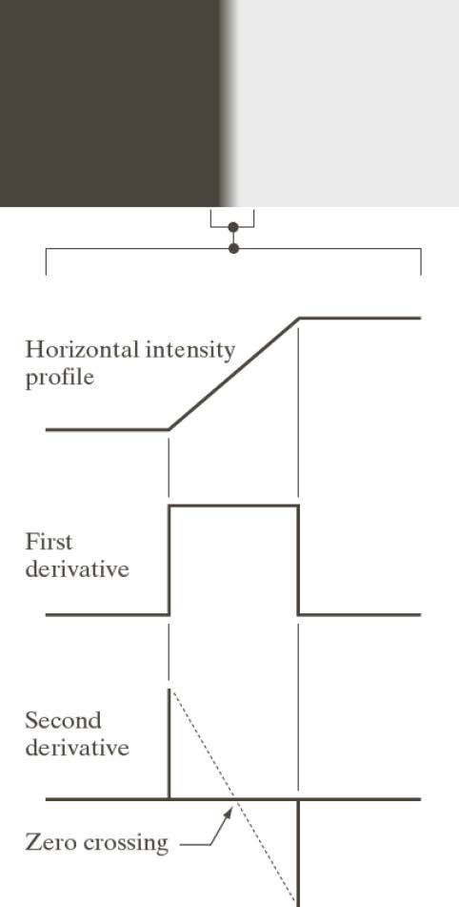
Ramp edges
in real images, ramp edges are the most common (due to blurring)
the first derivative can be used to detect an edge
the sign of the second derivative tells if the pixel is on the dark or light side of the edge
the second derivative:
produces a double response (undesirable)
allows the exact edge localization through zero crossing

Slide 10
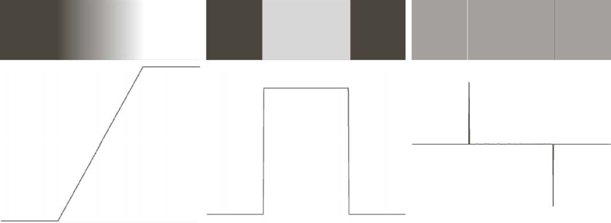
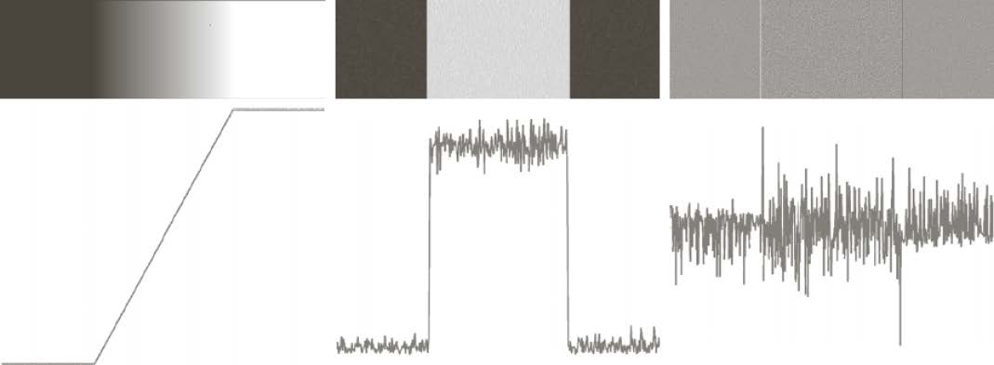
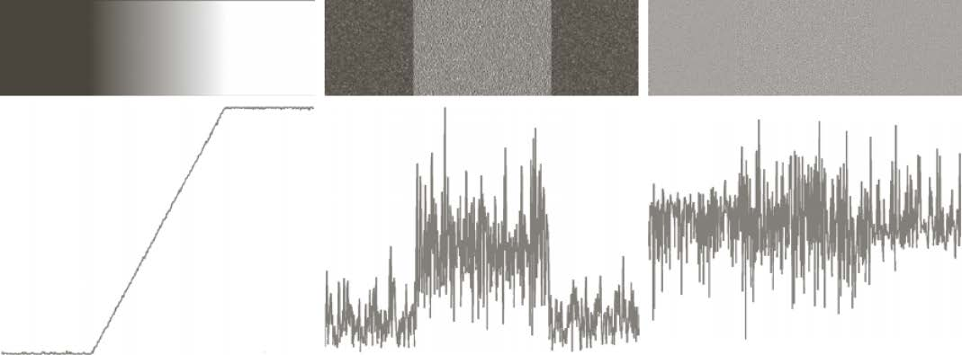
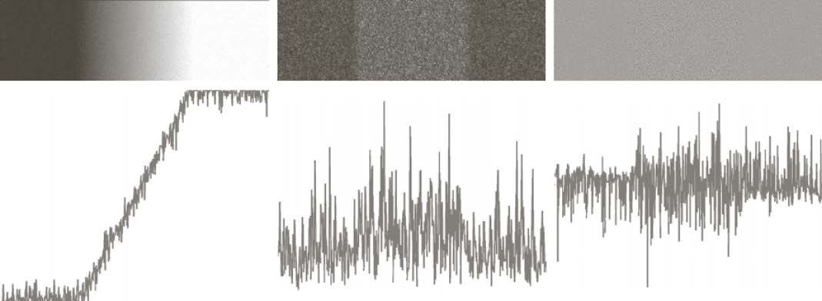
Edges, noise, and derivatives
although noise is almost invisible in the images, even a tiny amount of noise strongly affects the second derivative and a modest amount of noise can ruin the first derivative
since derivative operators are the principal tool for edge detection, their effectiveness in real image can be questioned
three fundamental steps have to be performed in edge detection:
smoothing for noise reduction
detection of edge points
edge localization

Slide 11
Gradient-based edge detection

Slide 12
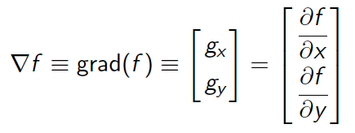
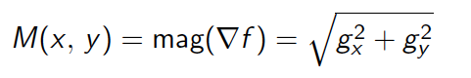
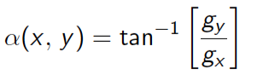
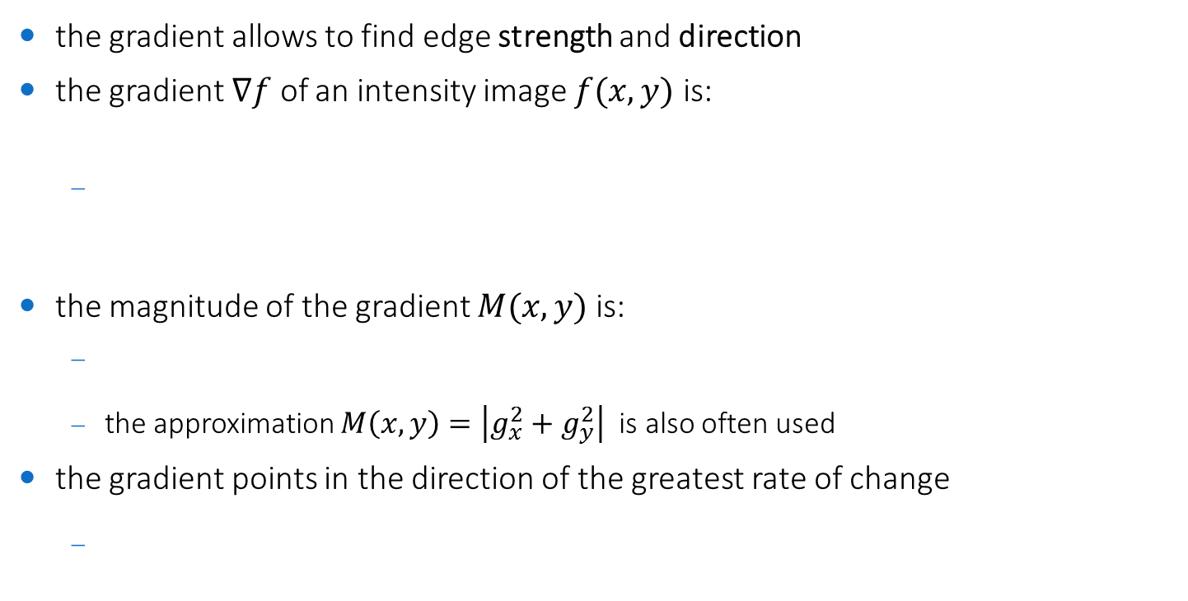
Gradient of an image
the gradient allows to find edge strength and direction
the gradient $∇f$ of an intensity image $f(x,y)$ is:
the magnitude of the gradient $M(x,y)$ is:
the approximation $M\left(x,y\right)=\left|g_{x}^{2}+g_{y}^{2}\right|$ is also often used
the gradient points in the direction of the greatest rate of change

Slide 13
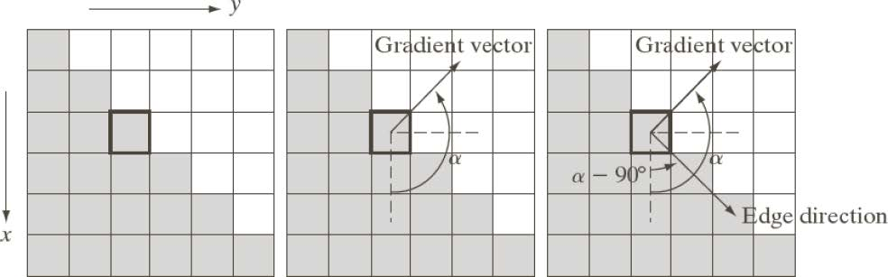
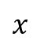
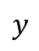
Edge and gradient
the direction of the edge is orthogonal to the direction of the gradient
gradient is also called edge normal
$$x$$
$$y$$

Slide 14
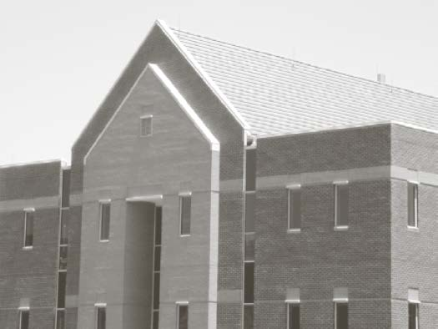
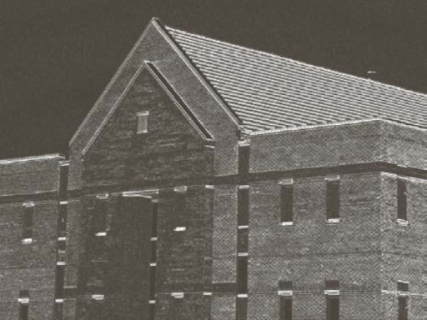
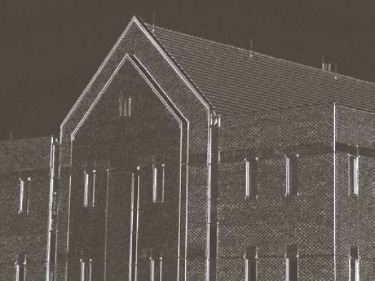
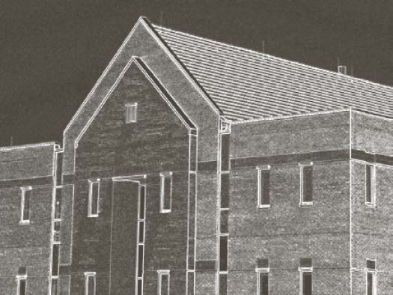
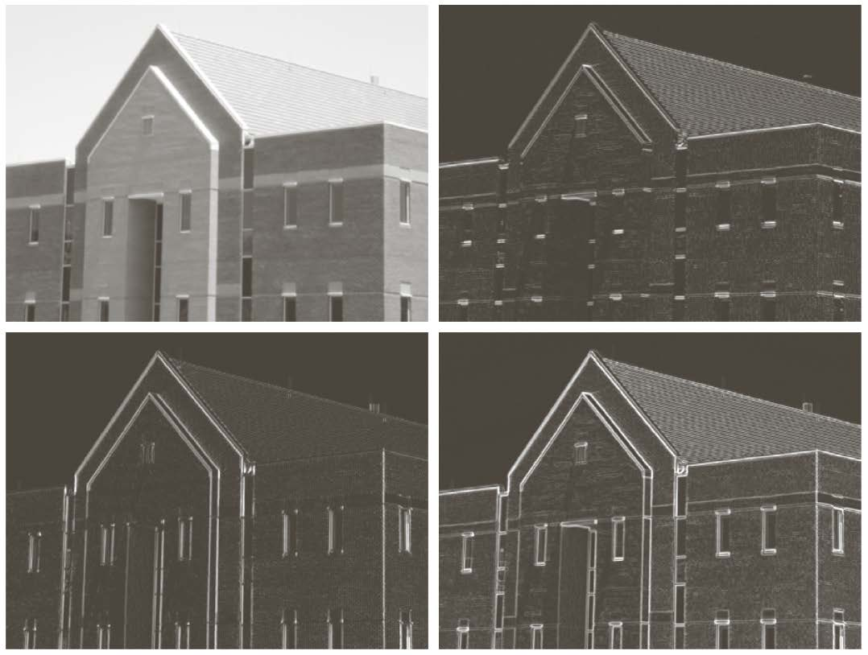
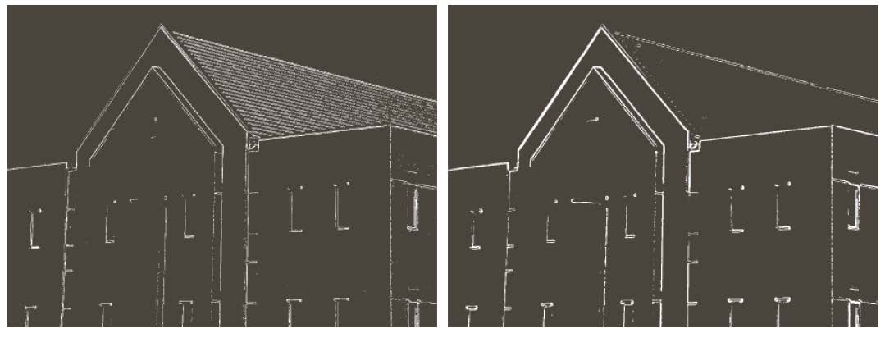
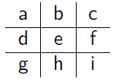
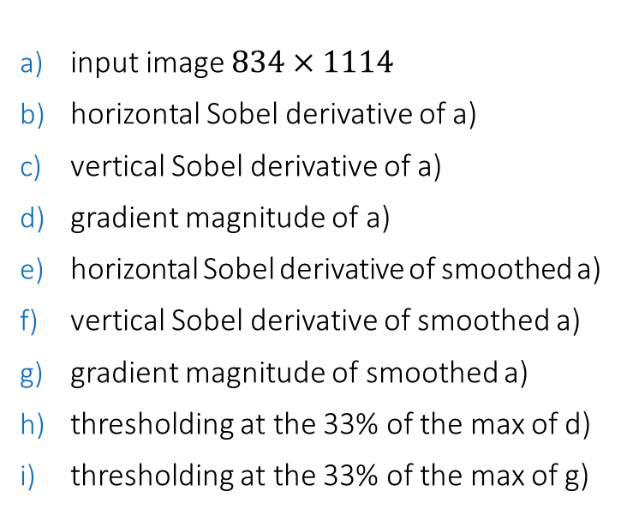
An example (*)
input image $834×1114$
horizontal Sobel derivative of a)
vertical Sobel derivative of a)
gradient magnitude of a)
horizontal Sobel derivative of smoothed a)
vertical Sobel derivative of smoothed a)
gradient magnitude of smoothed a)
thresholding at the 33% of the max of d)
thresholding at the 33% of the max of g)
(*) example code available in labs/ocv-gradient-edge-detection.cpp

Slide 15
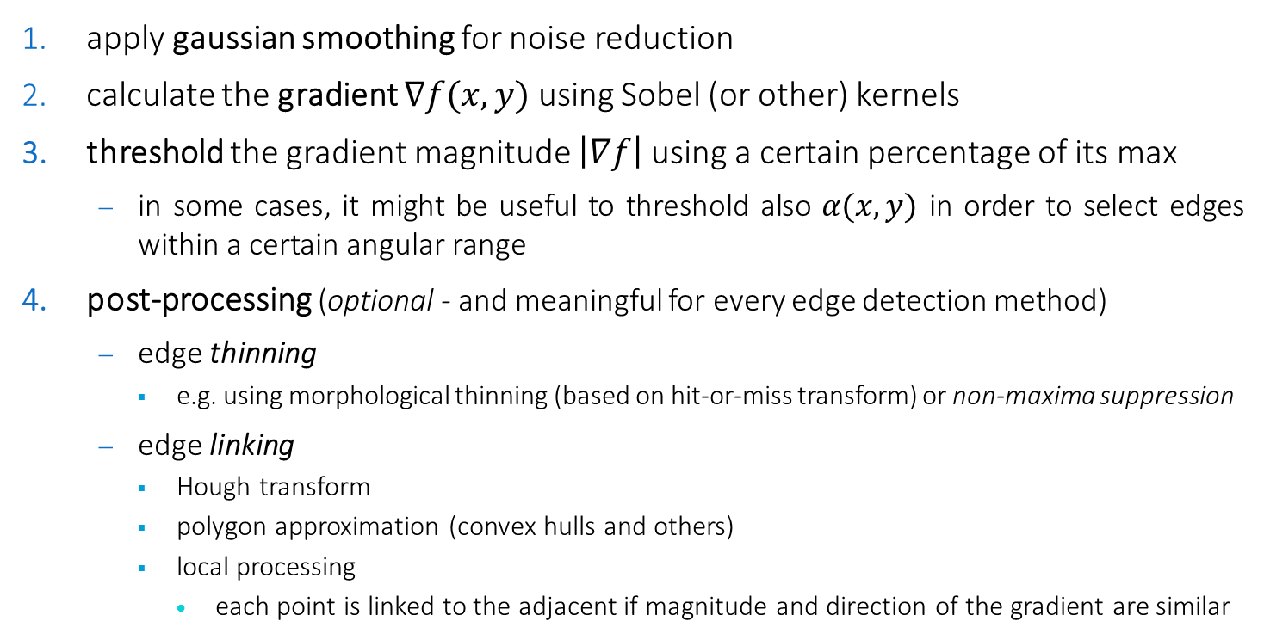
Gradient-based edge detection: the basic algorithm
apply gaussian smoothing for noise reduction
calculate the gradient $∇f(x,y)$ using Sobel (or other) kernels
threshold the gradient magnitude $\left|∇f\right|$using a certain percentage of its max
in some cases, it might be useful to threshold also $α(x,y)$ in order to select edges within a certain angular range
post-processing (optional - and meaningful for every edge detection method)
edge thinning
e.g. using morphological thinning (based on hit-or-miss transform) or non-maxima suppression
edge linking
Hough transform
polygon approximation (convex hulls and others)
local processing
each point is linked to the adjacent if magnitude and direction of the gradient are similar

Slide 16
Marr-Hildredth / LoG edge detection

Slide 17
Marr-Hildreth edge detector
the Marr-Hildreth edge detector is based on two observations:
intensity changes are not independent of image scale
operators that can act at different scales must be used
the derivatives of the function carry useful information on changes of intensity
derivative operators must be used
the Laplacian of the Gaussian satisfies both the requirements
used in multiresolution image pyramids processing (blending)
the Gaussian is smooth both in the spatial and in the frequency domains
result is less affected by artifacts
the Laplacian is isotropic
no need of multiple masks for covering different directions
e.g. Sobel is not isotropic (it can be combined with diagonal Sobel kernels for diagonal edges)

Slide 18
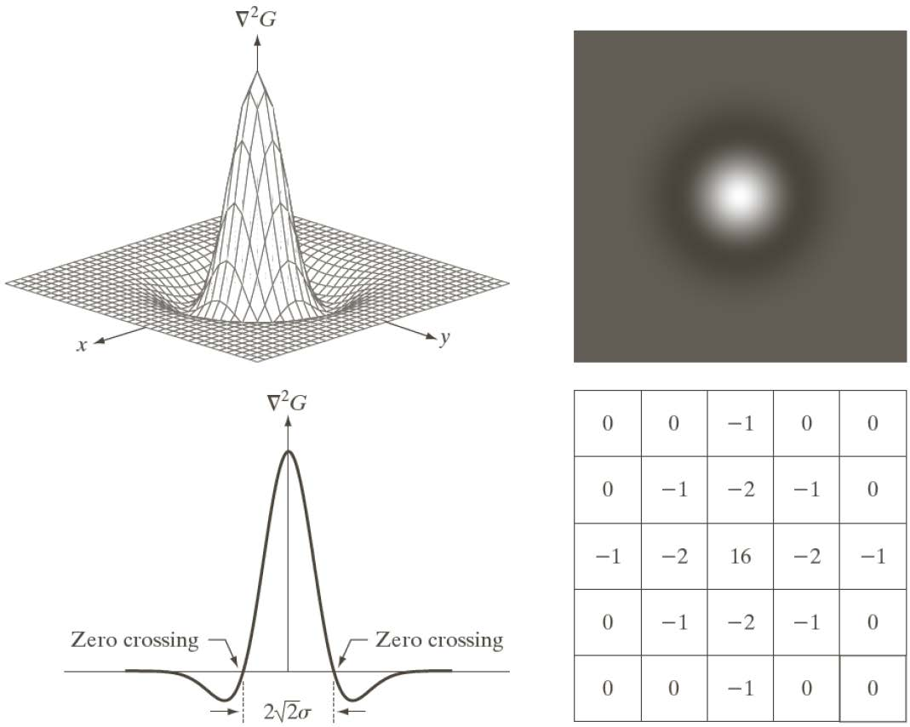
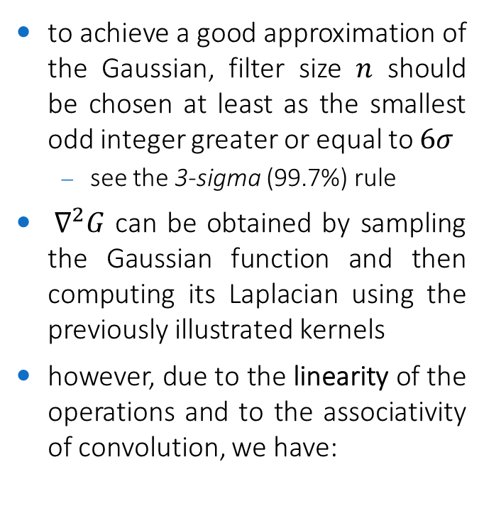

The Laplacian of the Gaussian (LoG)
to achieve a good approximation of the Gaussian, filter size $n$ should be chosen at least as the smallest odd integer greater or equal to $6σ$
see the 3-sigma (99.7%) rule
$∇^{2}G$ can be obtained by sampling the Gaussian function and then computing its Laplacian using the previously illustrated kernels
however, due to the linearity of the operations and to the associativity of convolution, we have:
$$\left[∇^{2}G\right]∗f=∇^{2}[G∗f]$$

Slide 19
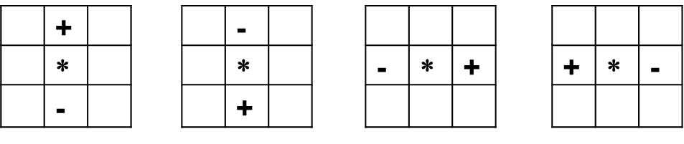
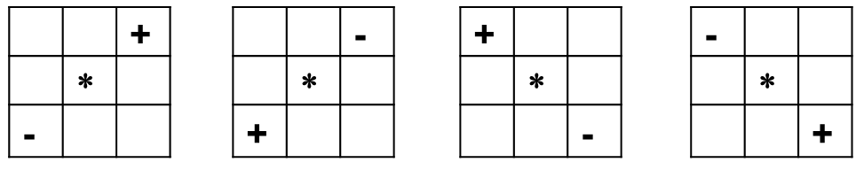
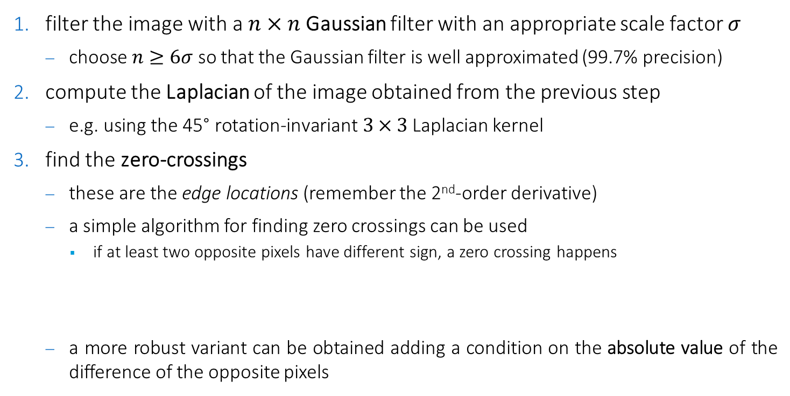
The Marr-Hildreth algorithm
filter the image with a $n×n$Gaussian filter with an appropriate scale factor $σ$
$\text{choose} n≥6σ$ so that the Gaussian filter is well approximated (99.7% precision)
compute the Laplacian of the image obtained from the previous step
$\text{e}\text{.}\text{g}\text{. }\text{using} \text{the}\text{ 45° }\text{rotation}\text{−}\text{invariant} 3×3$Laplacian kernel
find the zero-crossings
$\text{these} \text{are} \text{the} \text{edge} \text{locations}$ (remember the 2nd-order derivative)
a simple algorithm for finding zero crossings can be used
if at least two opposite pixels have different sign, a zero crossing happens
a more robust variant can be obtained adding a condition on the absolute value of the difference of the opposite pixels

Slide 20
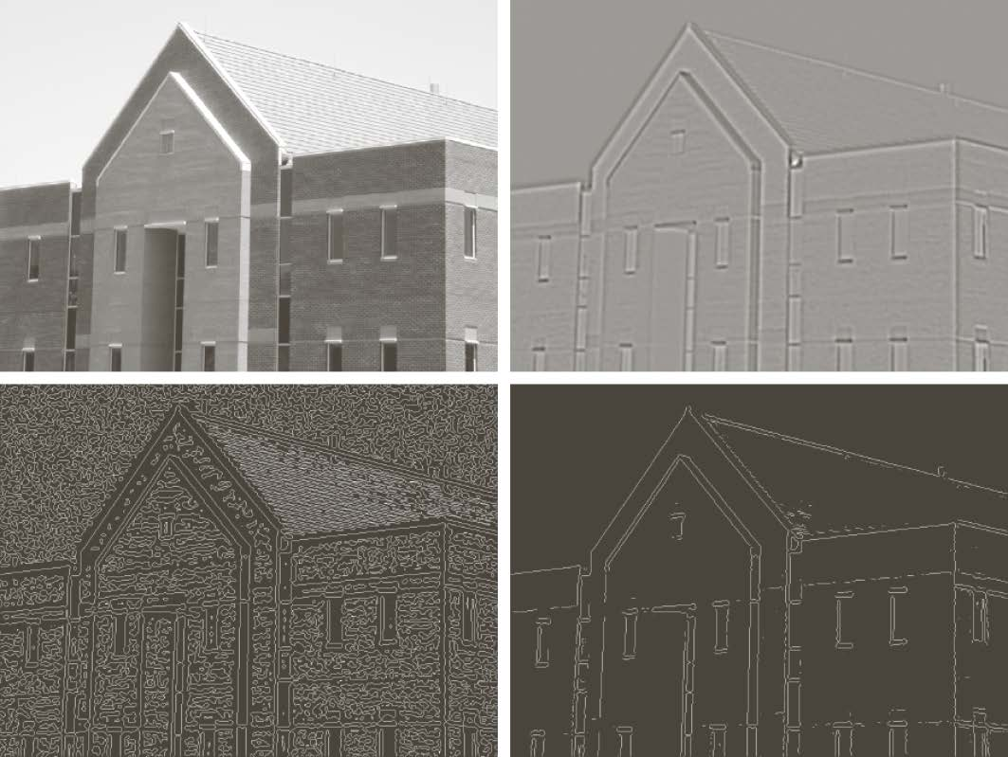
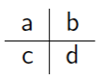
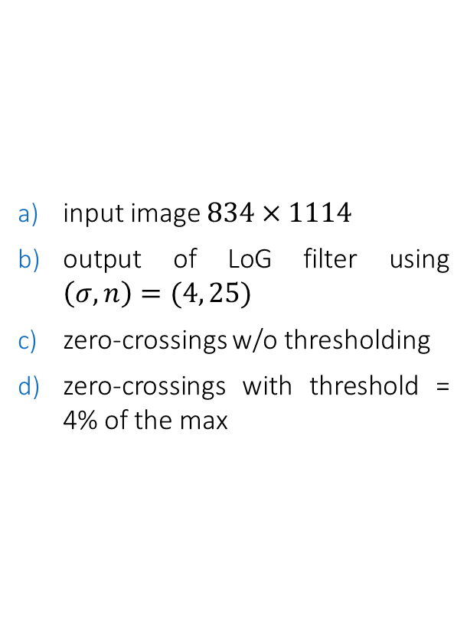
An example (*)
input image $834×1114$
output of LoG filter using $\left(σ,n\right)=(4, 25)$
zero-crossings w/o thresholding
zero-crossings with threshold = 4% of the max
(*) example code available in labs/ocv-marrhildreth-edge-detection.cpp

Slide 21
Canny edge detection

Slide 22
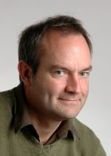
Canny's criteria (*)
general criteria for edge detection
low error rate
no missing edges, no false edges
well localized edge points
the edge point detected from the operator should accurately localize on the center of the edge
single edge point response
a given edge in the image should only be marked once, and where possible, image noise should not create false edges
Canny translated these criteria into math...
(*) more details in the 1986 paper in canny/canny-pami-paper.pdf

Slide 23

Canny's model
edge model:
ramp edge corrupted by additive white gaussian noise
edge detector:
convolution filter with antisymmetric response defined
an edge is detected as the maximum of the convolution between the image and the filter
the filter is numerically determined as the solution of an optimization problem following the Canny's criteria
the optimal Canny's edge detector can be well approximated by the derivative of a Gaussian
generalizing this to 2-D would require to process the image for all the directions
convolving the image with a Gaussian and then computing the gradient provides a good approximation

Slide 24


Canny's algorithm
filter the image with a $n×n$Gaussian filter with an appropriate scale factor $σ$
$\text{choose} n≥6σ$ so that the Gaussian filter is well approximated (99.7% precision)
compute the Gradient Image of the image obtained from the previous step
$\text{e}\text{.}\text{g}\text{. }\text{using} \text{the} \text{Sobel} \text{kernel}$
apply non-maximum suppression to get rid of spurious response to edge detection (edge thinning)
$\text{r}\text{obust} \text{detection} \text{and} \text{linking} \text{of} \text{the} \text{edge} \text{points} \text{based} \text{on} \text{hysteresis} \text{thresholding}$

Slide 25

Non-maxima suppression
the gradient vector (edge normal) direction is approximated to one of the four principal directions
horizontal, vertical, and diagonal
if at least one of the neighboring pixels along the edge direction has a gradient magnitude larger, the corresponding pixel in the gradient image is set to 0 (suppression)
otherwise it is set to the gradient value

Slide 26

Hysteresis thresholding and edge linking
let be $g_{N}(x,y)$ the gradient image after non-maxima suppression
hysteresis thresholding
let be $T_{H}$ and $T_{L}$ two thresholds (high and low) so that $T_{L}<T_{H}$
typically $2≤\frac{T_{H}}{T_{L}}≤3$
$g_{NL}\left(x,y\right)≜T_{L}≤g_{N}\left(x,y\right)≤T_{H}$
contains also weak edge points, but edges are linked
$g_{NH}\left(x,y\right)≜g_{N}\left(x,y\right)≥T_{H}$
contains only strong edge points, but edges are broken
edge linking
for every point in $g_{NH}$, mark as valid all the points in $g_{NL}$ that are 8-connected to the considered points
at the end, all the valid edge points in $g_{NL}$ are added to $g_{NH}$

Slide 27


Gradient vs. Marr-Hildreth vs. Canny
input image $834×1114$
Gradient-based edge detection
Marr-Hildreth
Canny

Slide 28

Gradient vs. Marr-Hildreth vs. Canny
CT image
Gradient-based edge detection
Marr-Hildreth
Canny
(*) example code available in labs/ocv-canny-edge-detection.cpp

Slide 29
Region-based Segmentation (Thresholding, Region Growing, Region Splitting and Merging)

Slide 30




Thresholding
Thresholding is the simplest segmentation method
pixels are partitioned depending on their intensities
Global thresholding, using a fixed threshold $T$:
Variable thresholding, if $T$ changes over the image
local or regional thresholding, if $T$ depends on a neighborhood of $(x, y)$
Multiple thresholding

Slide 31

Region Growing
a technique based on a controlled growing of some initial pixels (seeds)
seeds are manually or automatically selected based on appropriate criteria
depend on the a-priori knowledge on the problem
e.g., pixels in a certain grayscale range
regions are grown from the seed points to (4- or 8-) connected points depending on a region membership criterion
e.g., pixel intensity, texture, or color similarity
a stop rule might be needed
depends on the a-priori knowledge on the problem

Slide 32

Region Growing: the basic algorithm
given:
$f (x, y)$, the image to be segmented
$S(x, y)$, binary image with the seeds (it is 1 only where the seeds are located)
$Q$, predicate to be tested for each location $\left(x, y\right)$
a simple region growing algorithm (based on $8$-connectivity) is:
erode all the connected components of $S$ until they are only one pixel wide
generate the binary image $f_{Q}$ such that $f_{Q}(x,y)=1$ if $Q(x,y)$ is true.
create the binary image $g$ where $g(x, y) = 1$ if $f_{Q}(x,y)=1$ and $(x, y)$ is 8-connected to a seed in $S$
the resulting connected components in $g$ are the segmented regions

Slide 33


Region Growing: an example
x-ray image $f$ showing defective welds
histogram of $f$
defects saturate the intensity (first clue)
inizial seeds$S\left(x,y\right)≔f\left(x,y\right)=255$
final seeds $S^{∗}\left(x,y\right)$ $≔$erosion of $S$
$f_{inv}=255−f$
histogram of $f_{inv}$
there is a valley that separates the welds from the rest of the image (second clue)
$f_{inv}>65$
segmentation by region growing from $S^{∗}$ with $Q≔f_{inv}≤65$

Slide 34

Region splitting and merging
iterative subdivision of the image in homogeneous regions (splitting)
joining of the adjacent homogeneous regions (merging)
given an image $f$ and a predicate $Q$, the basic algorithm is:
be $R_{0}=f$
iterative subdivision in quadrants of each region $R_{i}$ for which $Q\left(R_{i}\right)=false$
when $Q\left(R_{i}\right)=true$ for every region, merge those adjacent regions $R_{i}$ and $R_{j}$ such that $Q\left(R_{i}∪R_{j}\right)=true$
repeat step 3 until no merging is possible
optionally, at each merge step, replace the pixels in $R_{i}$ with the mean value in $R_{i}$ (homogenization filtering)

Slide 35



Region splitting and merging: quadtree-based partitioning

Slide 36



Region splitting and merging: examples
image of Cassiopeia nebula
(unknown wavelength)
splitting/merging with $Q$ and blocks $32×32$
splitting/merging with $Q$ and blocks $16×16$
splitting/merging with $Q$ and blocks $8×8$
$$Q\left(R_{i}\right)≔σ\left(R_{i}\right)>θ_{1} AND avg\left(R_{i}\right)∈[0,θ_{2}]$$

Slide 37



Region splitting and merging: examples

Slide 38
Mean-shift Segmentation (based on Mean-shift filtering)

Slide 39


Mean-shift image filtering
a local homogenization technique that is very useful for damping shading or tonality differences in localized objects
it replaces each pixel with the mean of the pixels in a neighborhood defined in a joint spatial-color domain (feature space)
similar to (but more powerful than) bilateral filtering!

Slide 40

Example
in this example, the mean-shift filtering separates / clusters 3 different levels
103 103 103 103 103 103 106 104
103 147 147 153 147 156 153 104
107 153 153 153 153 153 153 107
103 153 147 96 98 153 153 104
107 156 153 97 96 147 153 107
103 153 153 147 156 153 153 101
103 156 153 147 147 153 153 104
103 103 107 104 103 106 103 107
104 104 104 104 104 104 104 104
104 152 152 152 152 152 152 104
104 152 152 152 152 152 152 105
104 152 152 97 97 152 152 104
104 152 152 97 97 152 152 104
104 152 152 152 152 152 152 104
104 152 152 152 152 152 152 104
104 104 104 104 104 104 104 104

Slide 41


Overview (*)(**)
suppose we work in a 1-D feature space made only by intensity values
search windows are distributed over the entire feature space and their means are computed
window size can be fine-tuned depending on specific applications
(*) intensity samples are not the same as in the previous example
(**) this is just to give an idea of how MS works, but it is not the way it exactly works

Slide 42


Overview
the windows are shifted to the locations equal to their previously computed means
steps 1.) and 2.) are repeated until convergence, i.e. until all windows have settled on final locations

Slide 43


Overview
the windows that end up on the same locations are merged
the data are clustered according to the window traversals
e.g. all data that was traversed by windows that ended up at, say, location “2”, will form a cluster associated with that location

Slide 44


Towards a more formal definition (*)
consider, again, a set of points in a boring, 1-D feature space
obviously, we would like to generate two groups, corresponding to the two parts of the feature space in which we have a high density of points
how can we capture this notion of high density?
kernel density estimation (KDE)
(*) simplifications will be adopted. For a 100% formal definition, see the additional materials in the /mean-shift folder

Slide 45

Gradient ascent
if we had a continuous function instead of a bunch of data points, we could find the maxima by gradient ascent
how can we convert our set of points to a continuous function?

Slide 46


Kernel
let us define a kernel function $K(x)$, with the properties:
decays to zero far from $0$
is maximum at $0$
is symmetric

Slide 47


Kernel Density Estimation
we can define the kernel at each data point $x_{i}$ and sum up the result into a single function
$\hat{f}\left(x\right)=\sum_{i}{K(x−x_{i})}$
approximates the probability that feature $x$ is observed given the data points ${\left\{x_{i}\right\}}_{i=1,…,n}$

Slide 48



Kernel Density Estimation
to avoid overfitting, a smoothing parameter $h$ is used to scale the kernel
$\hat{f}\left(x\right)=\sum_{i}{K\left(\frac{x−x_{i}}{h}\right)}$
$h$ too small (e.g. $h=1$) leads to overfitting (too many modes)
$h$ too large smooths out the details of the data (only a few / one mode)

Slide 49



Which kernel?
we are interested to a special class of radially symmetric kernels satisfying
$K\left(x\right)=c∙k\left({\left\|x\right\|}^{2}\right)$
where $k(t)$ is called kernel profile (defined only for $ℝ^{+}$)
we now have that
$\hat{f}\left(x\right)=\sum_{i}{K\left(\frac{x−x_{i}}{h}\right)=\sum_{i}{k\left(\frac{{\left\|x−x_{i}\right\|}^{2}}{h^{2}}\right)}}$
which is known as Parzen window technique
Epanechnikov kernel profile $k\left(t\right)=1−t, t∈[0,1]$ is a widely used choice
its associated kernel $K$ maximizes the asymptotic mean integrated squared error (AMISE) w.r.t the choice of $h$

Slide 50


Kernel Density Gradient Estimation
and now, where we do we go?
we want to climb cliffs to find local peaks (modes) of the PDF
we should follow the gradient...
$∇\hat{f}\left(x\right)=…=\sum_{i}{\left(x−x_{i}\right)k′\left(\frac{{\left\|x−x_{i}\right\|}^{2}}{h^{2}}\right)}$
let us now define a new kernel profile $g\left(x\right)=−k′(x)$
$∇\hat{f}\left(x\right)=\sum_{i}{\left(x_{i}−x\right)g\left(\frac{{\left\|x−x_{i}\right\|}^{2}}{h^{2}}\right)}$
$∇\hat{f}\left(x\right)=…=\left[\sum_{i}{g\left(\frac{{\left\|x−x_{i}\right\|}^{2}}{h^{2}}\right)}\right]\left[\frac{\sum_{i}{x_{i}g\left(\frac{{\left\|x−x_{i}\right\|}^{2}}{h^{2}}\right)}}{\sum_{i}{g\left(\frac{{\left\|x−x_{i}\right\|}^{2}}{h^{2}}\right)}}−x\right]$
Mean shift vector $m(x)$
Difference between $x$and the mean of the data points weighted by $g(∙)$(points further from $x$
count less)
this is a number
this is a vector

Slide 51


The Mean-Shift Algorithm
key result: the mean shift vector points in the same direction as the PDF gradient!
idea: iteratively move in the direction of the mean shift vector
Mean-Shift Algorithm
let be $y$ the data point we want to move to its nearest PDF mode
$y$is one of the data points ${\left\{x_{i}\right\}}_{i=1,…,n}$ (and we will do this for each pixel of the image!)
let be $y_{0}=y$ the initial location (in the feature space) of $y$
at each iteration $j$, move $y_{j}$ by its corresponding mean shift vector
$y_{j+1}=y_{j}+m\left(y_{j}\right)=\frac{\sum_{i}{x_{i}g\left(\frac{{\left\|y_{j}−x_{i}\right\|}^{2}}{h^{2}}\right)}}{\sum_{i}{g\left(\frac{{\left\|y_{j}−x_{i}\right\|}^{2}}{h^{2}}\right)}}$
until convergence, i.e. stop when |$∇\hat{f}\left(y\right)|<ε$ (close to zero)
guaranteed with a finite number of steps with the Epanechnikov kernel
i.e., replace $y_{j}$ with its locally weighted mean

Slide 52





The Mean-Shift Algorithm (with Epanechnikov kernel)
remember Epanechnikov kernel profile $k\left(t\right)=1−t, t∈\left[0,1\right]$
then $g\left(t\right)=−f^{′}\left(t\right)=1$ if $0≤t≤1$
i.e., replace $y_{j}$ with the average of the data points $x_{i}$ within a radius $h$ of $y_{j}$
$$y_{j+1}=y_{j}+m\left(y_{j}\right)=\frac{\sum_{\left\|y_{j}−x_{i}\right\|≤h}{x_{i}}}{\sum_{\left\|y_{j}−x_{i}\right\|≤h}{1}}$$
generalization

Slide 53




Mean-shift image filtering
we now want to apply the Mean-Shift Algorithm to an image
a.k.a. Mean-shift image filtering (MSIF)
which feature space?
color (a.k.a. range) domain?
distant pixels having similar colors will converge to the same color $→$ ugly results

Slide 54



Mean-shift image filtering
we now want to apply the Mean-Shift Algorithm to an image
a.k.a. Mean-shift image filtering (MSIF)
which feature space?
color (a.k.a. range) domain?
distant pixels having similar colors will converge to the same color $→$ ugly results
spatial domain?
pixels close to each other will converge to the same color $→$ smoothing / blurring effects
joint spatial-color domain?
ok, but location $x_{s}=\left(x,y\right)$ and color $x_{r}=\left(r,g,b\right)$ have different scales!
we can combine two kernels with two different bandwidth parameters into a single kernel!
$$K\left(x\right)=K\left({\left(x_{s}|x_{r}\right)}^{T}\right)=k\left(\frac{{\left\|x_{s}\right\|}^{2}}{h_{s}^{2}}\right)∙k\left(\frac{{\left\|x_{r}\right\|}^{2}}{h_{r}^{2}}\right)$$
$h_{s}$ and $h_{r}$are the spatial and range kernel bandwidths and the only 2 parameters of MSIF

Slide 55

Mean-shift image filtering

Slide 56


Mean-shift image filtering
$$\left(h_{s},h_{r}\right)=(8, 7)$$

Slide 57


Mean-shift image filtering
$$\left(h_{s},h_{r}\right)=(16, 7)$$

Slide 58

Mean-shift image filtering
$$\left(h_{s},h_{r}\right)=(8, 7)$$

Slide 59

Mean-shift image filtering
the $(r,g,b)$ color part of the feature can be replaced by other color components such as CIE $(L^{∗},u^{∗},v^{∗})$
the feature space can be further enriched with texture components (e.g., bank of filter outputs) or multispectral components where available
is it doable to add other dimensions to the feature space? $→$ more modes will be found...and...
the fundamental operation to compute the kernels is to find the neighbors within some radius (defined by the kernel bandwidth)
this can be very expensive in high dimension with lots of points (e.g. images)
the complexity is $O({Tn}^{2})$ ($n$ = number of pixels, $T$= number of steps)
a number of optimizations have been proposed, for instance:
e.g. multilevel / multiresolution image pyramid (*)
cv::pyrMeanShiftFiltering(InputArray src, OutputArray dst, double sp, double sr, int maxLevel=1)
(*) example code available in labs/ocv-mean-shift-filtering.cpp

Slide 60


Mean-Shift Segmentation
filtering is the first step of mean shift segmentation process
the Mean-Shift algorithm can yield many modes
a second (required) step is the clustering of filtered data points
e.g. group together (cluster) all pixels that are closer than $h_{s}$ in the spatial domain and $h_{r}$ in the radiometric/color domain
optional: eliminate spatial regions containing less than $M$ pixels
...or other image analysis technique that performs the segmentation

Slide 61




Mean-Shift Segmentation
$$\left(h_{s},h_{r},M\right)=(8, 7, 100)$$
$$\left(h_{s},h_{r},M\right)=(16, 19, 40)$$

Slide 62
Watershed (the Watershed Transform)

Slide 63

Overview
a region growing approach based on a topological interpretation of the (gradient) image
intensity represents the height of the terrain that describes mountains and basins
under the ground there is water, colored water
for each basin, a hole in its minimum is made, from which the rising water spills and fills the basins
as the water rises, differently colored basins meet
dams are constructed to keep basins separated
these dams are the borders of the regions of the segmentation

Slide 64



Overview (in 3D)
dams

Slide 65



Algorithm (essentials)
regional minima are manually / automatically determined
usually on the gradient image $g(x,y)$ (e.g. by thresholding)
the topography is flooded in integer flood increments, from $n =g_{min}⁡+ 1$to $n =g_{max}⁡+ 1$
pixels below the plane $g(x, y )=n$are marked "white"
if we look down on the $xy$-plane, we see a binary image in which white pixels are those below the plane $g\left(x, y\right)=n$
let us call these pixels $T\left[n\right]=\left\{\left(x,y\right) | g\left(x,y\right)<n\right\}$
at each step $n$ of the flooding process we compare each connected component $q_{i}∈T\left[n\right]$with $p_{j=1,…}∈T\left[n−1\right]$
if $|\left\{q_{i}∩p_{j=1, …}\right\}|=0 →$ $q_{i}$ is a new region (nothing to do)
if $|\left\{q_{i}∩p_{j=1, …}\right\}|=1 →$ $q_{i}$ is growing region (nothing to do)
if $\left|\left\{q_{i}∩p_{j=1, …}\right\}\right|>1 →$ $q_{i}$ is a merged region (dam construction)

Slide 66



Dam construction
dams can be built using morphological dilation
starting from the last step before merging, dilation can be performed until the two disjoint components become connected
a small SE must be is used (e.g. $3×3$)
the dams can be realized setting the pixels at $L$
where the levels of intensity are in $[0, L − 1]$

Slide 67

An "easy" example
cells image
the gradient magnitude of a)
resulting watershed segmentation
dams overimposed to a)

Slide 68



Another example: oversegmentation
noise as well as irrelevant details make difficult the application of the watershed technique in real images
gradient (first derivative) enhances all local changes / intensity transitions
oversegmentation can be produced
these problems can be handled limiting the flooding through markers
the watershed algorithm can then be applied considering the markers as the only minimum points from which the procedure is started
Marker-controlled Watershed

Slide 69

Marker-controlled Watershed

Slide 70


Marker-controlled Watershed
internal markers
associated to the object of interest to be segmented
should be within homogeneous regions of the image on which watershed is applied
manually or automatically determined
e.g. using gradients / grayscale morphology / other tools
external markers
associated to the background
manually or automatically determined
e.g. the dams obtained by the first-pass of the Watershed that uses only the internal markers (like in this example)

Slide 71




The Watershed segmentation paradigm
Input Image $I$
Thresholding/Gradient
Grayscale Morphology Distance Function
other tools...
markers $$M$$
segmentation criterion/ function $F$
intelligent part
mechanical part
$$watershed( F\left(I\right), M )$$
Segmentation

Slide 72

A "hard" example
3-cells image (noisy)
gradient of a)
useless / too noisy
opening of a)
closing of c)
c) + d) = alternating sequential filtering (ASF)

Slide 73


A "hard" example
gradient of d)
watershed on e) using local minima
useless: we need markers
another ASF iteration on d)
bottop-hat of g) + thresholding
useful: we have internal markers now!

Slide 74

A "hard" example
watershed on the gradient of g) with internal markers of h)
useful: we have external markers now!
internal and external markers overimposed on the gradient of g)
watershed on the gradient of g) with both internal and external markers
final segmentation result

Slide 75









Watershed to segment overlapping objects (*)
pills.jpg image ($296×192$)
binarization with Otsu
opening $3×3$ to remove noise
distance transform on c)
each foreground (white) pixel is set to the distance to the closest background (black) pixel
thresholding on d)
"inner" pixels have the highest intensity $→$internal markers
external markers = contour of the dilation of c) with a SE $21×21$
watershed result
(*) example code available in labs/ocv-watershed.cpp

Slide 76

Magic Wand like object selection with Watershed (*)
(*) see full video in /watershed/magic_wand_demo.mp4
(*) example code available in labs/ocv-watershed-magic-wand.cpp

